Slide 1
TIME SERIES FORCASTING

Slide 2
Introduction:
A time series is a sequence of observations over a certain period.
A univariate time series consists of the values taken by a single variable at periodic time instances over a period.
A Multivariate time series consists of the values taken by multiple variables at the same periodic time instances over a period.
The simplest example of a time series that all of us come across on a day to day basis is the change in temperature throughout the day or week or month or year.
The analysis of temporal data is capable of giving us useful insights on how a variable changes over time, or how it depends on the change in the values of other variable(s). This relationship of a variable on its previous values and/or other variables can be analyzed for time series forecasting and has numerous applications in artificial intelligence.

Slide 3
Components of Time Series
A time series has 4 components as given below −
Level − It is the mean value around which the series varies.
Trend − It is the increasing or decreasing behavior of a variable with time.
Seasonality − It is the cyclic behavior of time series.
Noise − It is the error in the observations added due to environmental factors.

Slide 4
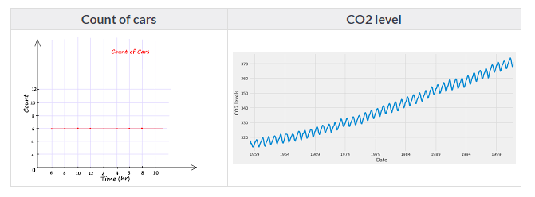
Let’s start with some basics:
Which of the following do you think is an example of time series?
Time Series is generally data which is collected over time and is dependent on it.
Here we see that the count of cars is independent of time, hence it is not a time series. While the CO2 level increases with respect to time, hence it is a time series.
Let us now look at the formal definition of Time Series.
A series of data points collected in time order is known as a time series. Most of business houses work on time series data to analyze sales number for the next year, website traffic, count of traffic, number of calls received, etc. Data of a time series can be used for forecasting.

Slide 5
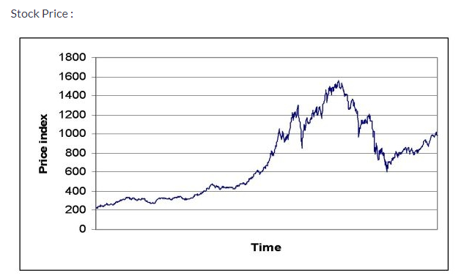
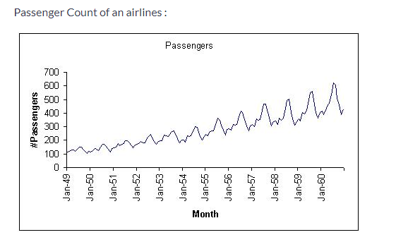
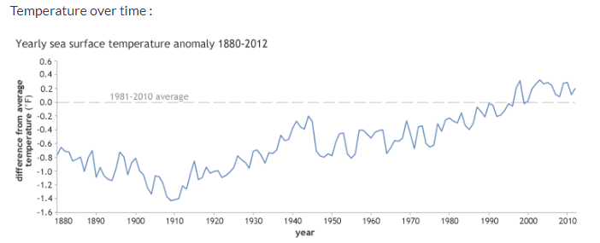
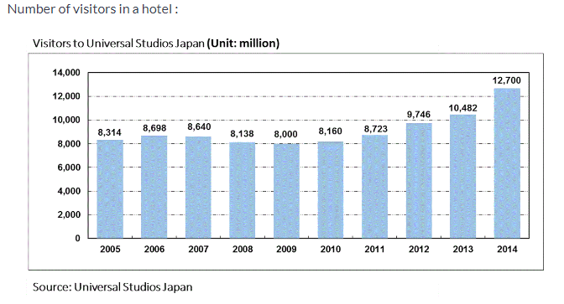
Not every data collected with respect to time represents a time series. Some of the examples of time series are:

Slide 6
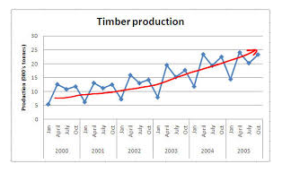
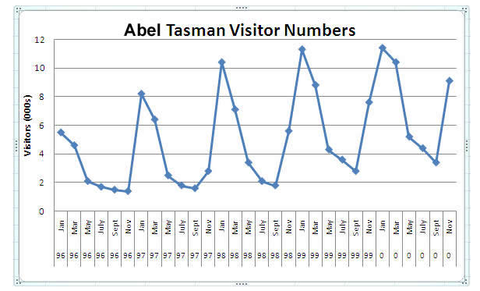
Major Components of a Time Series
Trend : Trend is a general direction in which something is developing or changing. So we see an increasing trend in this time series. We can see that the passenger count is increasing with the number of years. Let’s visualize the trend of a time series:
Seasonality : Another clear pattern can also be seen in the above time series, i.e., the pattern is repeating at regular time interval which is known as the seasonality. Any predictable change or pattern in a time series that recurs or repeats over a specific time period can be said to be seasonality. Let’s visualize the seasonality of the time series:

Slide 7
Difference between a time series and regression problem
Here you might think that as the target variable is numerical it can be predicted using regression techniques, but a time series problem is different from a regression problem in following ways:
The main difference is that a time series is time dependent. So the basic assumption of a linear regression model that the observations are independent doesn’t hold in this case.
Along with an increasing or decreasing trend, most Time Series have some form of seasonality trends, i.e. variations specific to a particular time frame.
So, predicting a time series using regression techniques is not a good approach.
Time series analysis comprises methods for analyzing time series data in order to extract meaningful statistics and other characteristics of the data. Time series forecasting is the use of a model to predict future values based on previously observed values.

Slide 8
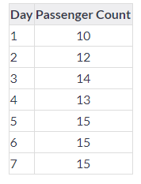
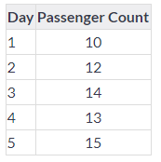
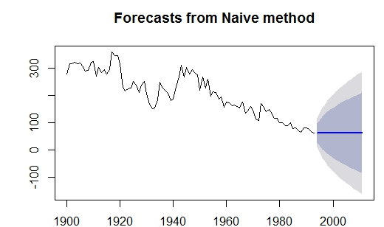
Various methods of Time series
Naive Approach
In this forecasting technique, we assume that the next expected point is equal to the last observed point. So we can expect a straight horizontal line as the prediction. Lets understand it with an example and an image:
Suppose we have passenger count for 5 days as shown below:
And we have to predict the passenger count for next 2 days. Naive approach will assign the 5th day’s passenger count to the 6th and 7th day, i.e., 15 will be assigned to the 6th and 7th day.

Slide 9
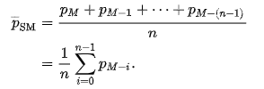
Moving Average
In this technique we will take the average of the passenger counts for last few time periods only. A moving average (rolling average or running average) is a calculation to analyze data points by creating a series of averages of different subsets of the full data set. It is also called a moving mean (MM) or rolling mean and is a type of finite impulse response filter. Variations include: simple, and cumulative, or weighted forms.
There are various forms of Moving Average:
Simple Moving Average:
In financial applications a simple moving average (SMA) is the unweighted mean of the previous n data. However, in science and engineering, the mean is normally taken from an equal number of data on either side of a central value. This ensures that variations in the mean are aligned with the variations in the data rather than being shifted in time. An example of a simple equally weighted running mean for a n-day sample of closing price is the mean of the previous n days' closing prices.

Slide 10
2. Cumulative moving average
In a cumulative moving average (CMA), the data arrive in an ordered datum stream, and the user would like to get the average of all of the data up until the current datum point.
For example, an investor may want the average price of all of the stock transactions for a particular stock up until the current time. As each new transaction occurs, the average price at the time of the transaction can be calculated for all of the transactions up to that point using the cumulative average, typically an equally weighted average of the sequence of n values.
3. Weighted Moving Average
A weighted average is an average that has multiplying factors to give different weights to data at different positions in the sample window. Mathematically, the weighted moving average is the convolution of the datum points with a fixed weighting function.
In technical analysis of financial data, a weighted moving average (WMA) has the specific meaning of weights that decrease in arithmetical progression. In an n-day WMA the latest day has weight n, the second latest n − 1, etc., down to one.

Slide 11
Simple exponential smoothing
In this technique, we assign larger weights to more recent observations than to observations from the distant past.
The weights decrease exponentially as observations come from further in the past, the smallest weights are associated with the oldest observations.
NOTE - If we give the entire weight to the last observed value only, this method will be similar to the naive approach. So, we can say that naive approach is also a simple exponential smoothing technique where the entire weight is given to the last observed value.

Slide 12
Holt’s Linear Trend Model
It is an extension of simple exponential smoothing to allow forecasting of data with a trend.
This method takes into account the trend of the dataset. The forecast function in this method is a function of level and trend.
First of all let us visualize the trend, seasonality and error in the series.
We can decompose the time series in four parts.
Observed, which is the original time series.
Trend, which shows the trend in the time series, i.e., increasing or decreasing behavior of the time series.
Seasonal, which tells us about the seasonality in the time series.
Residual, which is obtained by removing any trend or seasonality in the time series.

Slide 13
Arima (auto-regression integrated moving average)
It is specified by three ordered parameters (p,d,q).
Here p is the order of the autoregressive model(number of time lags)
d is the degree of differencing(number of times the data have had past values subtracted)
q is the order of moving average model.
The ARIMA forecasting for a stationary time series is nothing but a linear (like a linear regression) equation.
What is a Stationary Time Series?
There are three basic criterion for a series to be classified as stationary series :
The mean of the time series should not be a function of time. It should be constant.
The variance of the time series should not be a function of time.
The covariance of the i^{th} term and the (i+m)^{th} term should not be a function of time.
Why do we have to make the time series stationary?
We make the series stationary to make the variables independent. Variables can be dependent in various ways, but can only be independent in one way. So, we will get more information when they are independent. Hence the time series must be stationary.
If the time series is not stationary, firstly we have to make it stationary. For doing so, we need to remove the trend and seasonality from the data.

Slide 14
Parameter tuning for ARIMA model
First of all we have to make sure that the time series is stationary. If the series is not stationary, we will make it stationary.
Stationarity Check
We use Dickey Fuller test to check the stationarity of the series.
The intuition behind this test is that it determines how strongly a time series is defined by a trend.
The null hypothesis of the test is that time series is not stationary (has some time-dependent structure).
The alternate hypothesis (rejecting the null hypothesis) is that the time series is stationary.
The test results comprise of a Test Statistic and some Critical Values for difference confidence levels. If the ‘Test Statistic’ is less than the ‘Critical Value’, we can reject the null hypothesis and say that the series is stationary.
We interpret this result using the Test Statistics and critical value. If the Test Statistics is smaller than critical value, it suggests we reject the null hypothesis (stationary), otherwise a greater Test Statistics suggests we accept the null hypothesis (non-stationary).

Slide 15
Removing Trend
A trend exists when there is a long-term increase or decrease in the data. It does not have to be linear.
We see an increasing trend in the data so we can apply transformation which penalizes higher values more than smaller ones, for example log transformation.
Removing Seasonality
By seasonality, we mean periodic fluctuations. A seasonal pattern exists when a series is influenced by seasonal factors (e.g., the quarter of the year, the month, or day of the week).
Seasonality is always of a fixed and known period.
We will use seasonal decompose to decompose the time series into trend, seasonality and residuals.
Forecasting the time series using ARIMA
First of all we will fit the ARIMA model on our time series for that we have to find the optimized values for the p,d,q parameters.
To find the optimized values of these parameters, we will use ACF(Autocorrelation Function) and PACF(Partial Autocorrelation Function) graph.
ACF is a measure of the correlation between the TimeSeries with a lagged version of itself.
PACF measures the correlation between the TimeSeries with a lagged version of itself but after eliminating the variations already explained by the intervening comparisons.

